Slide 1

Efficient Job Recommendation System Using Voting Classifier
Final Defense
2021

Slide 2
Supervisor
Md. Saifur Rahman
Assistant Professor
Department of CSE
Bangladesh University of Business & Technology (BUBT)

Slide 3
Presented By
Syeda Sumiha Jahan
Md. Shahin Shanaous
Md. Nurul Amin
Sakibul Islam
Md. Hasan Bhuiyan

Slide 4
Content
Introduction
Background
Motivation
Existing Works and Limitation
Implementation and Result Analysis
Future Work
Conclusion
Reference

Slide 5
01
Introduction
Job Recommendation
A recommender system is defined where the information provided by humans, and the system collects the data and gives appropriate instructions to the recipients.
02
Importance of Job Recommendation
Purpose of Job Recommendation
03

Slide 6
Background
01
02
Easy Resume Submission
Insecure System
Unpredictable Job
03

Slide 7

Motivation
Recommend Job
Secure System
Minimum Amount of Time

Slide 8
Existing Works and Limitation
1
In [1] authors proposed an approach that combines content-based recommender system approach for recommendation.
Limitation: They use information extracted from resumes to provide filters.
2
In [2] authors try to anticipate an employee's upcoming job change; their algorithm uses all previous job transitions and data linked with workers and institutions.
Limitation: They didn't even have a good idea of the social aspects

Slide 9
Existing Works and Limitation
3
In [3] authors proposed "Resume Classification and Matching" is an automated system that provides the time-saving ethical screening and shortlisting process.
Limitation: They used the Genism library in their proposed model.
4
In [4] authors proposed a similar concept of a machine learning-based job recommendation system into a multi-class classification problem.
Limitation: A little less accuracy has been noticed in their group models.

Slide 10
Existing Works and Limitation
5
In [5] authors proposed a system that used the Variable-Order Bayesian Network (VOBN) model. According to the verdicts, the VOBN model may give HR professionals accurate and interpretable insights.
Limitation: Their proposed model is more dependent on personal data.

Slide 11
Implementation and Result Analysis
Algorithms
2
1
Random Forest
K-nearest Neighbors
3
4
Naïve Bayes
Support Vector Machine
5
Voting Classifier

Slide 12
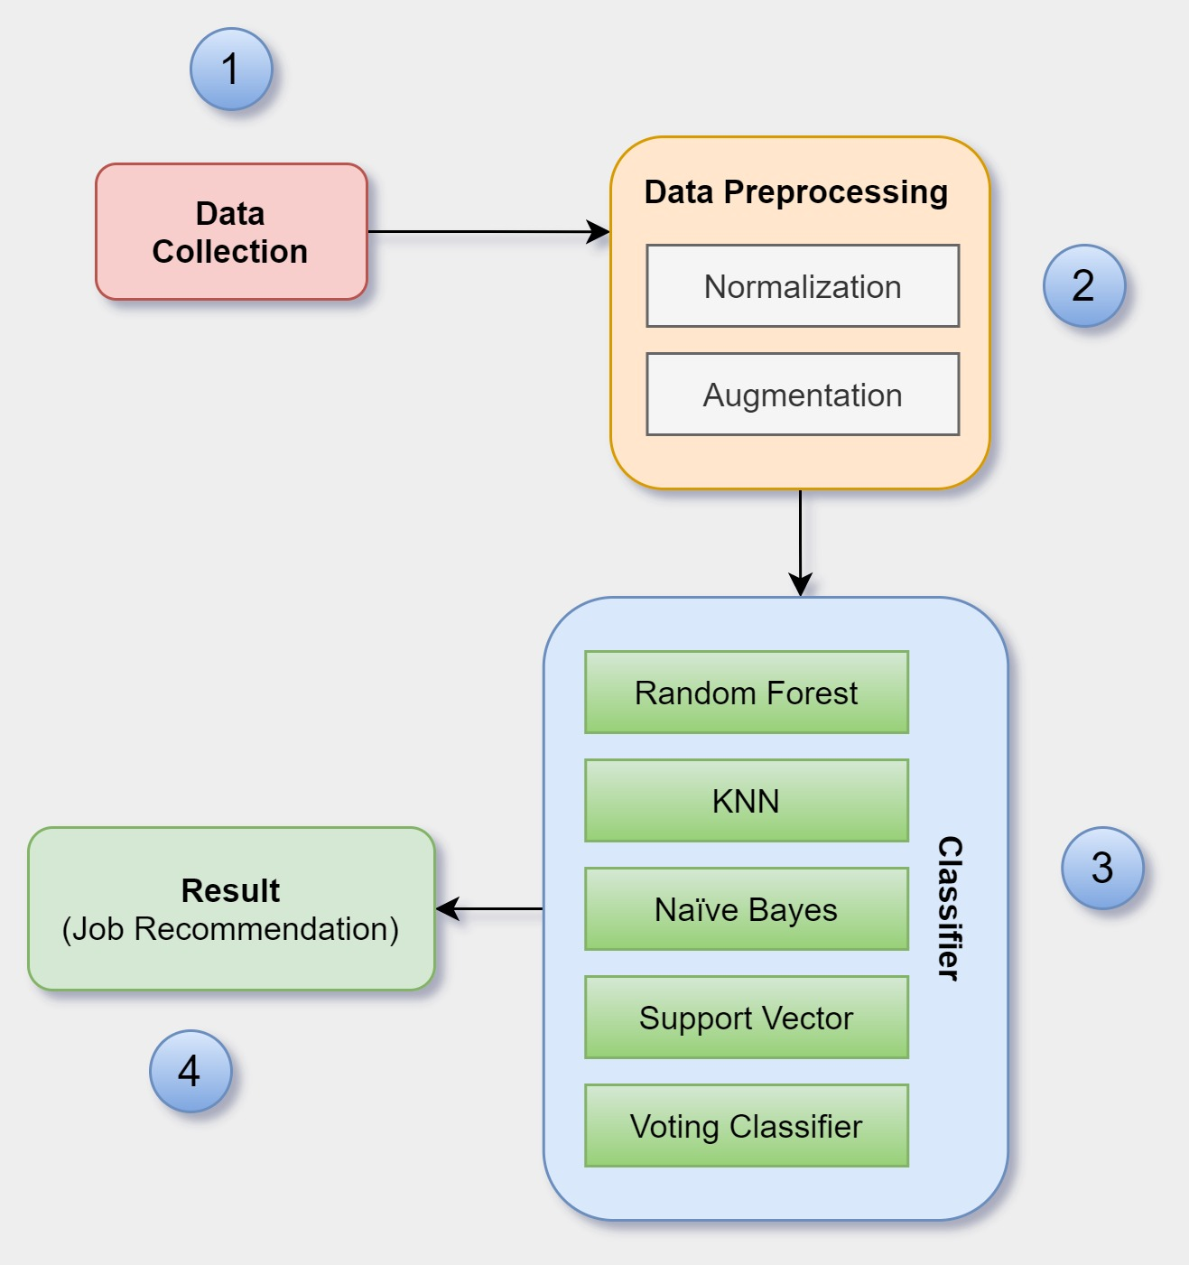
Implementation and Result Analysis
Workflow

Slide 13
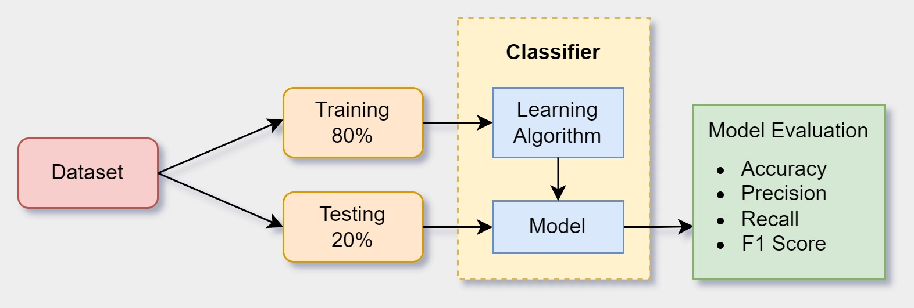
Implementation and Result Analysis
Implementation

Slide 14
Implementation and Result Analysis
Result Analysis
86%
89%
31%
83%
89%
Random Forest
K-nearest Neighbors
Support Vector Machine
Voting Classifier
Naïve Bayes

Slide 15
Future Work
Large Dataset
Deep Neural Network

Slide 16

Conclusion
Job Automation
Conductive Research Work
Comparing the Outcomes
89% Accuracy
Secured and Privacy Safeguarded

Slide 17
Reference
[1] Singh, Amit, Catherine Rose, Karthik Visweswariah, Vijil Chenthamarakshan, and Nandakishore Kambhatla. "PROSPECT: a system for screening candidates for recruitment." In Proceedings of the 19th ACM international conference on Information and knowledge management, pp. 659-668. 2010.
[2] Paparrizos, Ioannis, B. Barla Cambazoglu, and Aristides Gionis. "Machine learned job recommendation." In Proceedings of the fifth ACM Conference on Recommender Systems, pp. 325-328. 2011.
[3] Roy, Pradeep Kumar, Sarabjeet Singh Chowdhary, and Rocky Bhatia. "A Machine Learning approach for automation of Resume Recommendation system." Procedia Computer Science 167 (2020): 2318-2327.

Slide 18
Reference
[4] Appadoo, Kevin, Muhammad Bilaal Soonnoo, and Zahra MunglooDilmohamud. "Job Recommendation System, Machine Learning, Regression, Classification, Natural Language Processing." In 2020 IEEE Asia-Pacific Conference on Computer Science and Data Engineering (CSDE), pp. 1-6. IEEE, 2020.
[5] Pessach, Dana, Gonen Singer, Dan Avrahami, Hila Chalutz Ben-Gal, Erez Shmueli, and Irad Ben-Gal. "Employees recruitment: A prescriptive analytics approach via machine learning and mathematical programming." Decision Support Systems 134 (2020): 113290.

Slide 19
THANK YOU

